Slide 1

Stock Market Analysis and Prediction
Project Guide:
Dr. Abhay Kumar Agarwal
(Assistant Professor, KNIT Sultanpur)
Submitted by:
1) Aman Kumar Singh (14207)
2) Aman Sonkar (14208)
3) Ashutosh Rana (14215)
4) Rahul Kumar Gupta (14236)

Slide 2
1. Introduction
“Stock Market Analysis and Prediction” is a project on technical analysis, visualization and prediction using data provided by Morning Star.
This project is aimed at collecting the stock information for some previous years and then accordingly predicting the results that tells what would happen next.
The purpose of this project is to comparatively analyze the effectiveness of prediction algorithms on stock market data and get general insight on this data through visualization to predict future stock behavior and value at risk for each stock.
This project makes heavy use of Numpy, Pandas and other Data Visualization Libraries.
It encompasses the concept of Monte Carlo Simulation and Statistics.

Slide 3
2. Feasibility Analysis
We have evaluated the feasibility of the system in terms of the following categories:
Technical feasibility
Operational feasibility
Economic feasibility
Schedule feasibility

Slide 4
2. Feasibility Analysis
2.1 Technical Feasibility
Our Project "Stock Market Analysis and Prediction" is technically feasible since all the required tools are easily available.
The dataset required for analysis and prediction is easily available from Morning Star.
The framework used for connecting front-end with back-end is Flask which again not very difficult to implement.
2.2 Operational Feasibility
When it comes to its operation, the project looks more like a simplified web application.
It is simpler to operate and can be used in any webpage.
A user can very easily get the pertinent details on variations in stock prices of a company just by clicking a few tabs in the web page.

Slide 5
2. Feasibility Analysis
2.3 Economic Feasibility
Economic feasibility attempts to weigh the costs of developing and implementing a new system, against the benefits that would accrue from having the new system in place.
This is a web-based application. Creation of application is not costly.
2.4 Schedule Feasibility
Schedule feasibility is a measure that tells how reasonable the project timetable is.
The application development is feasible in terms of schedule.
Once the code got implemented, it did not take much time to complete rest of the project.

Slide 6
3. Requirement Definition
3.1 Functional Requirements
Functional requirement are the functions or features that must be included in any system to satisfy the business needs and be acceptable to the users. Based on this, the functional requirements that the system must require are as follows:
System should be able to process new stock data accessed from Morning Star.
System should be able to analyze data and classify each attribute.
System should be able to correctly find the risk value using Monte Carlo Simulation.

Slide 7
3. Non-functional requirements
3.2 Non-Functional Requirements
Portability: The website is completely portable and the recommendations is completely trustworthy as the data is dynamically updated.
Maintainability: The maintenance of the product would require training of the software by recent data so that their information is up to date.
Interoperability: The interoperability of the website is very high because it synchronize all the data with the morning star server.

Slide 8
4. Technologies Used
4.1 Front-end
HTML
CSS
JavaScript
Bootstrap

Slide 9
4. Technologies Used
4.2 Back-end
Python
Flask
Pandas
Numpy
4.3 API
The API used is from Morning Star.

Slide 10
5. Demonstration of the Project
5.1 Home Page
This gives the list various companies whose stock attributes are to be analyzed.
The figure below describes the attributes of Apple based on information obtained from Morning Star, which in turn takes data from Yahoo finance.
The Home Page begins with stock information of Apple.
The information in Apple stock is as follows:
Previous Close
Open
Volume
Average Volume

Slide 11
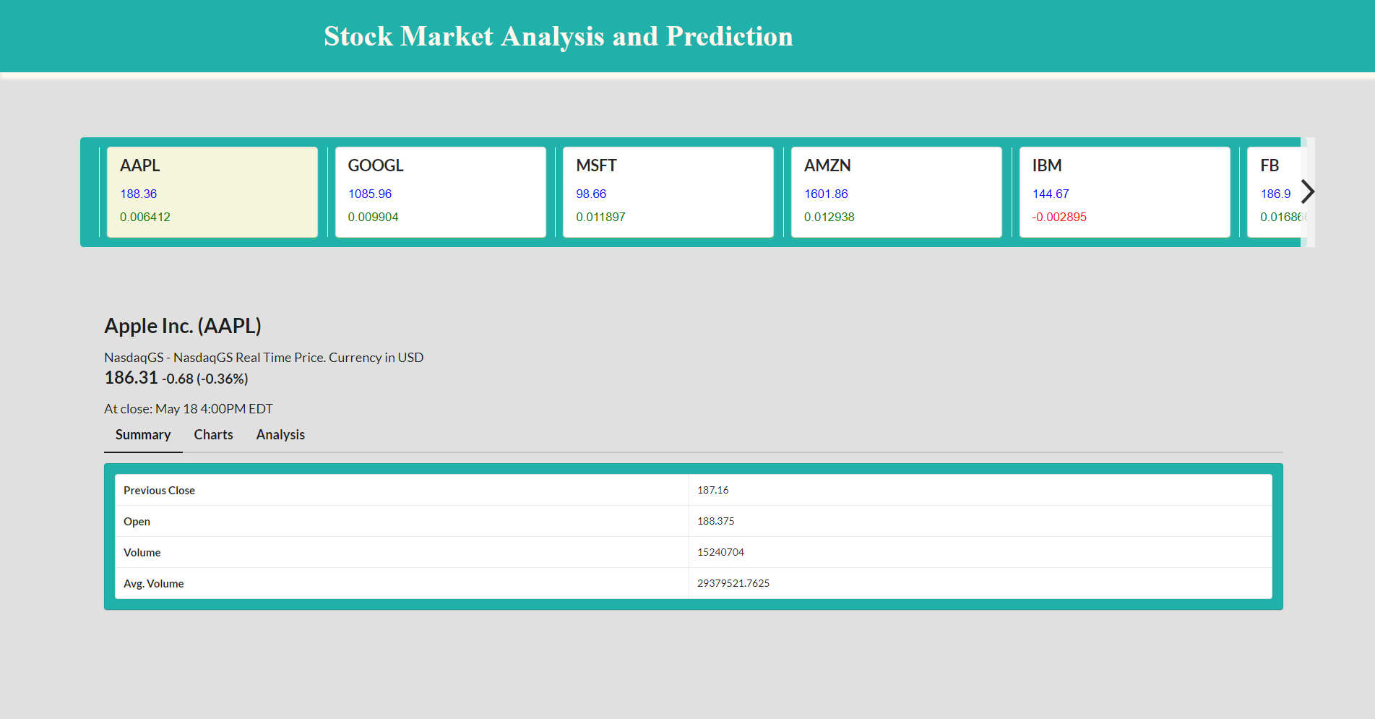

Slide 12
5. Demonstration of the Project
5.2 Close
The close describes the end of a trading session in the financial markets when the markets close.
It basically refer to the process of exiting a trade or the final procedure in a financial transaction in which contract documents are signed and recorded.
The closing price for Apple stock has been shown over a period of time.
The graph describes each day closing price of Apple stock.

Slide 13
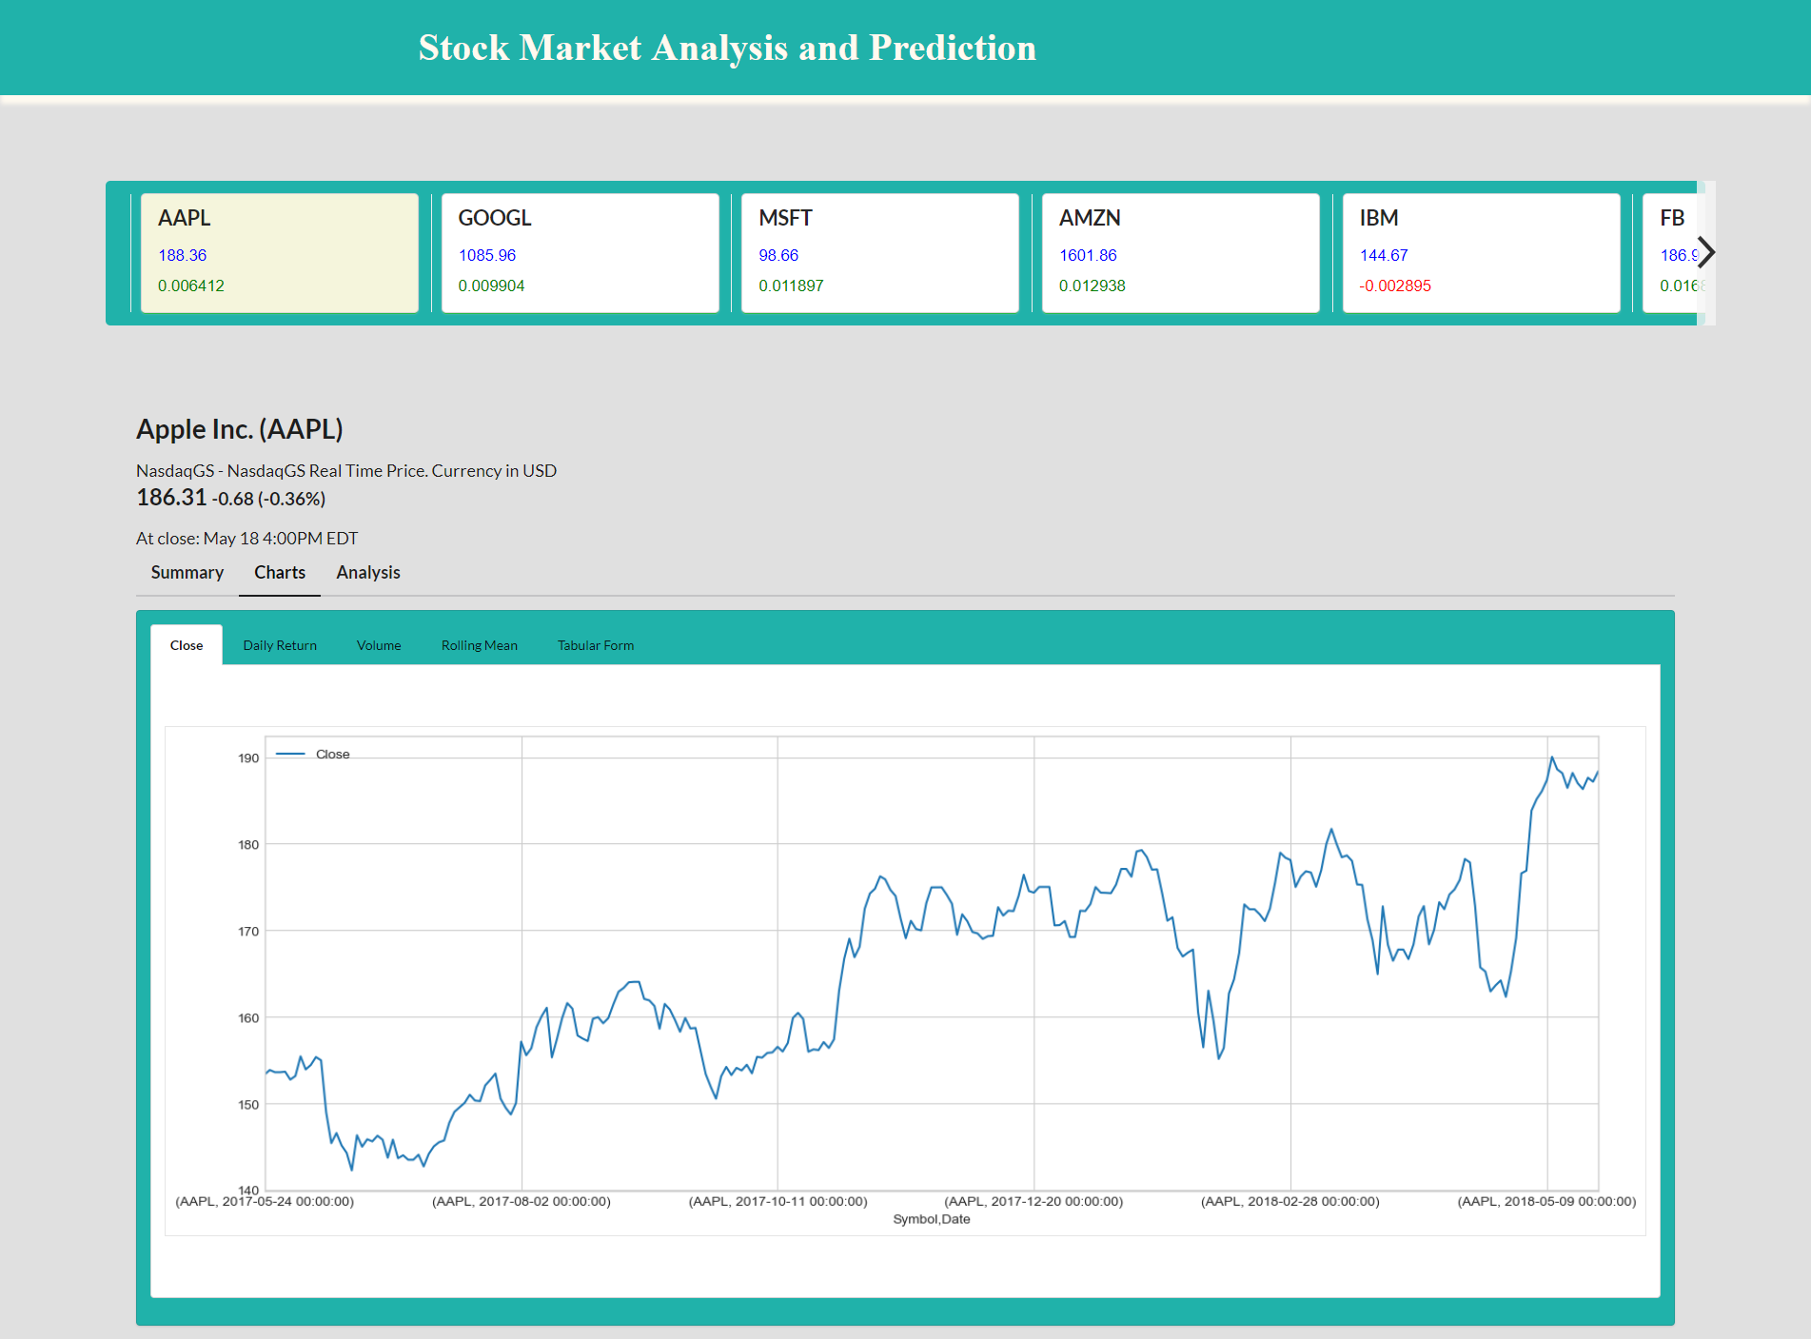

Slide 14
5. Demonstration of the Project
5.3 Daily Return
Stock prices change on a daily basis, altering the value of investment.
To tackle with this problem the concept of daily return comes in to picture.
Daily return measures the dollar change in a stock’s price.
This dollar change is calculated as the percentage of the previous day’s closing price.
A positive return means that the stock has grown in value while negative return means it has lost it value.

Slide 15
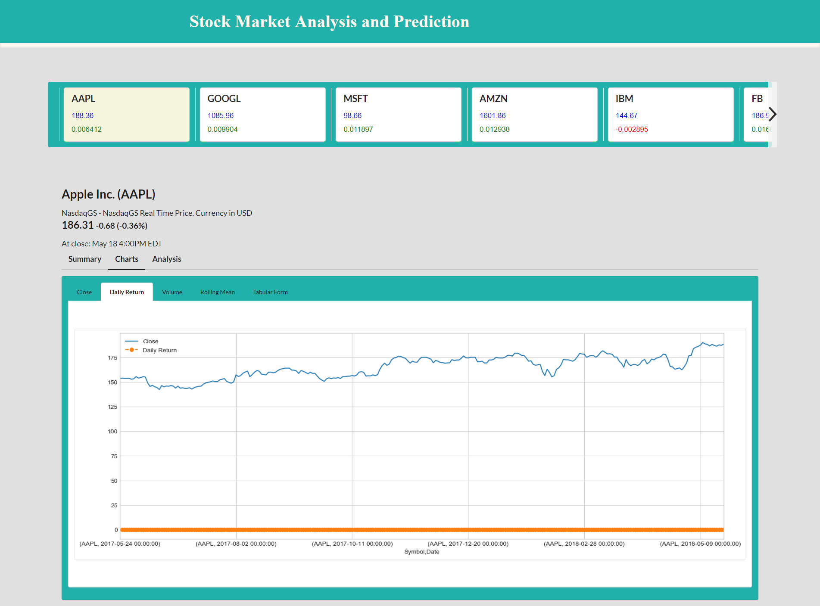

Slide 16
5. Demonstration of the Project
5.4 Volume
Volume is the number of shares traded in security or an entire market during a given period of time.
For every buyer, there is a seller, and each transaction contributes to the count of total volume.
When buyers and sellers agree to make a transaction at a certain price, it is considered one transaction.
If only five transactions occur in a day, the volume for the day is five.
The Volume graph of Apple stock has been shown in the next slide.

Slide 17
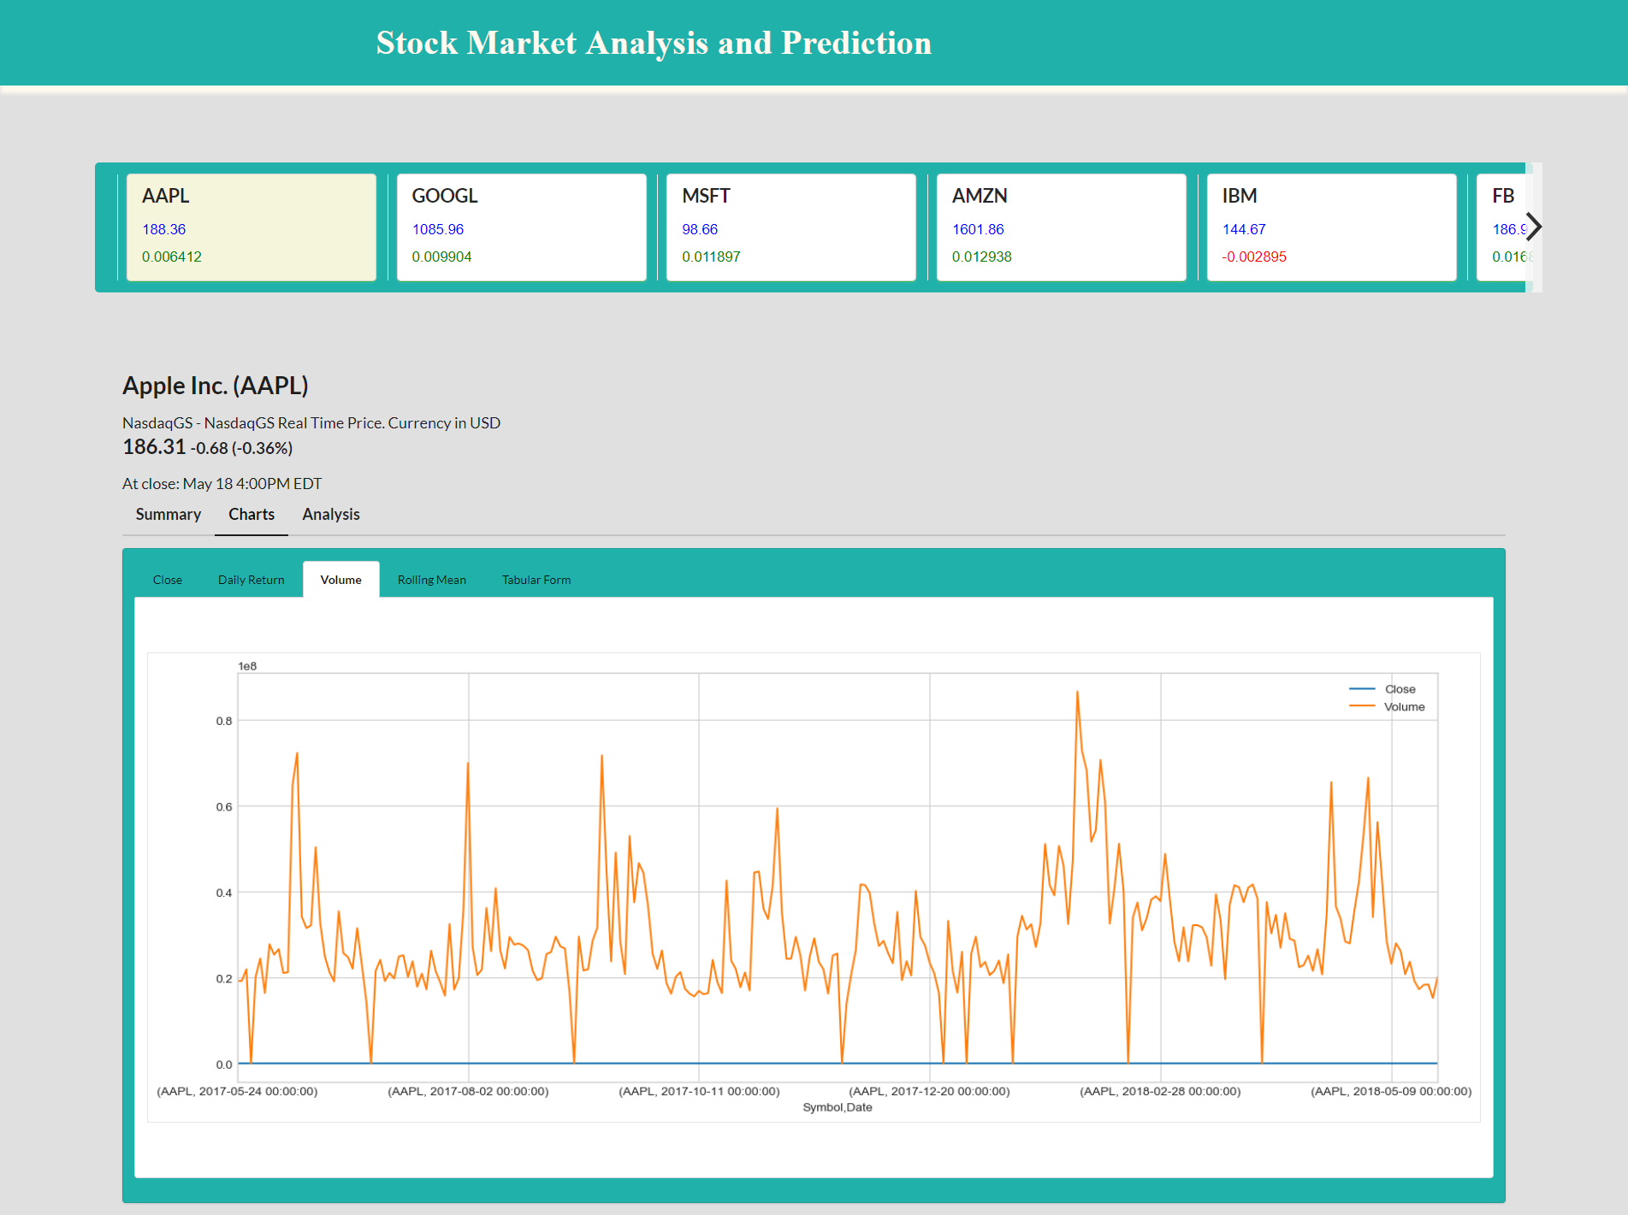

Slide 18
5. Demonstration of the Project
5.5 Rolling Mean
The moving average (MA) or rolling mean is a simple technical analysis tool that smooths out price data by creating a constantly updated average price.
A five-day simple moving average (SMA) adds up the five most recent daily closing prices and divides it by five to create a new average each day. Each average is connected to the next, creating the singular flowing line.
The average is taken over a specific period of time, like 10 days, 20 minutes, 30 weeks or any time period the trader chooses.
The rolling mean for Apple stock has been shown next.

Slide 19
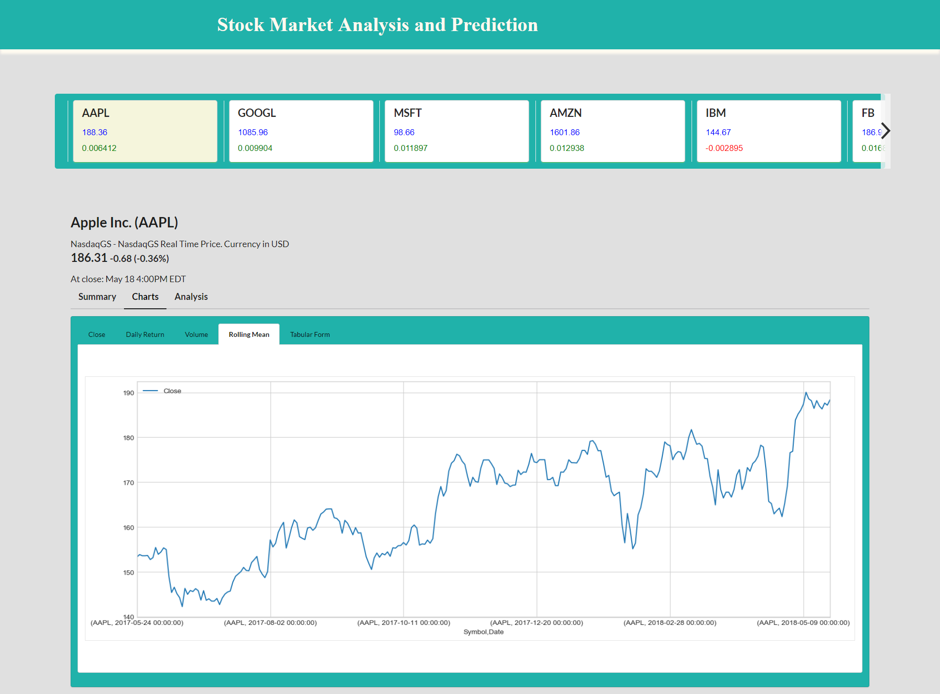

Slide 20
5. Demonstration of the Project
5. Tabular Form
The tabular form describes each price attribute of a company’s stock in terms of statistical measures.
Various statistical measures used are :
Mean
Standard deviation
Minimum
Maximum etc.

Slide 21
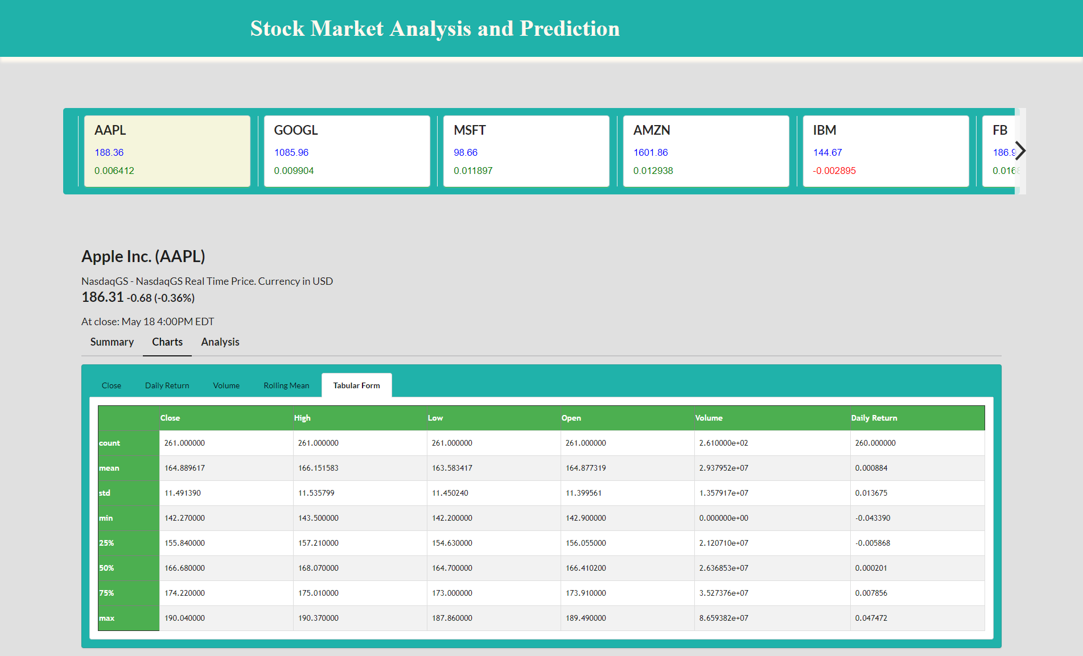

Slide 22
6. Methodology
After analysis, then comes the risk calculation.
For risk calculation methodology adopted are :
1) Bootstrap Method
2) Monte Carlo Simulation
These two methods helps us to find the risk in investment of a particular stock.
And therefore they suggest whether buying or selling a particular stock is desirable or not.
Consequently, the risk behaviour helps in prediction.

Slide 23
6. Methodology
6.1 Bootstrap Method
It is based on calculating the empirical quantile of a particular stock from a histogram
First of all a histogram is constructed.
From the histogram an empirical quantile (say 0.05) is calculated.
This empirical quantile when multiplied with investment gives the expected loss or gain.
Histogram for Apple stock has been shown next.

Slide 24
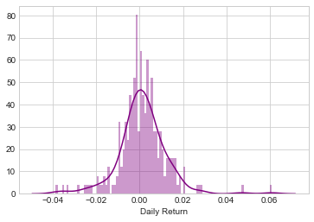
6. Methodology
-0.01655598896390161
The 0.05 empirical quantile of daily returns is at -0.016. That means that with 95% confidence, our worst daily loss will not exceed 1.6%. If we have a 1 million dollar investment, our one-day 5% VaR is 0.016 * 1,000,000 = $16,000.

Slide 25
6. Methodology
6.2 Monte Carlo Simulation
Using the Monte Carlo we run many trials with random market conditions.
Then we'll calculate portfolio losses for each trial.
Since random change is used for finding simulation, random changes get changed with time.
So, from time to time we get different simulations.
After this, we'll use the aggregation of all these simulations to establish how risky the stock is.
The simulation for Apple stock has been shown next.

Slide 26
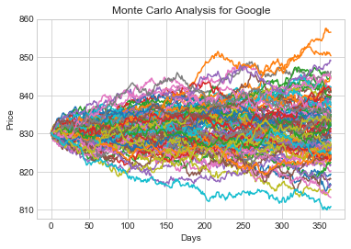

Slide 27
7. Limitations
The analysis is not static.
The risk calculation and prediction changes with time.
Persons having basic understanding of stock market will only be able to analyze the graphs.
It involves statistics and probability which is not liked by many people, so it may turn out to be less interesting.

Slide 28
8. Conclusion
Analysis of stock prices and daily return is done.
Moving average of various stocks is calculated.
Risk in investment of a particular stock is calculated.
Thus, it predicts whether it is safe to invest in a particular stock or not.

Slide 29
END
Thankyou

